Slide 1
Gesture control motor
👋
✋
👐
Project guide,
Dr. Jubilant J Kizhakkethottam
09 JUNE 2020
Project members,
Kiron M D
Sairam S
Shimil S Babu
🙌

Slide 2
ABSTRACT
Automation is the biggest domestic technological improvement of this generation.
Here we try to implement automation to an extent using the GESTURE CONTROLLED MOTOR.
One can control the movements of a motor using gestures.
GC Motors is a promising technology to improve lifestyle for the people and an excellent assist for Differently abled people, Old aged people, Dwarfs, etc

Slide 3
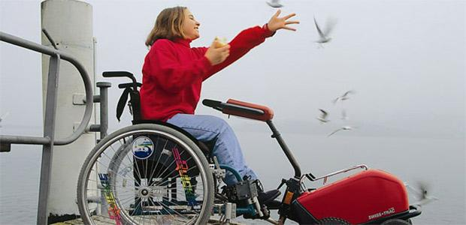
SOCIAL RELEVANCE
Simplify human life through controlling some of the day-to-day tasks using just gestures.
A motor can simplify some of the daily tasks of a human.
Project can provide improved life for the old-aged people and some differently abled people.
Fig. 1. Differently abled girl.

Slide 4
LITERATURE SURVEY
There are some controls that can be made upon motor for doing certain tasks.
We can control the motor by :
Motor control using relay and switches.
Voice controlled motor chip sets.
Remote controlled motors.
Data-glove.

Slide 5
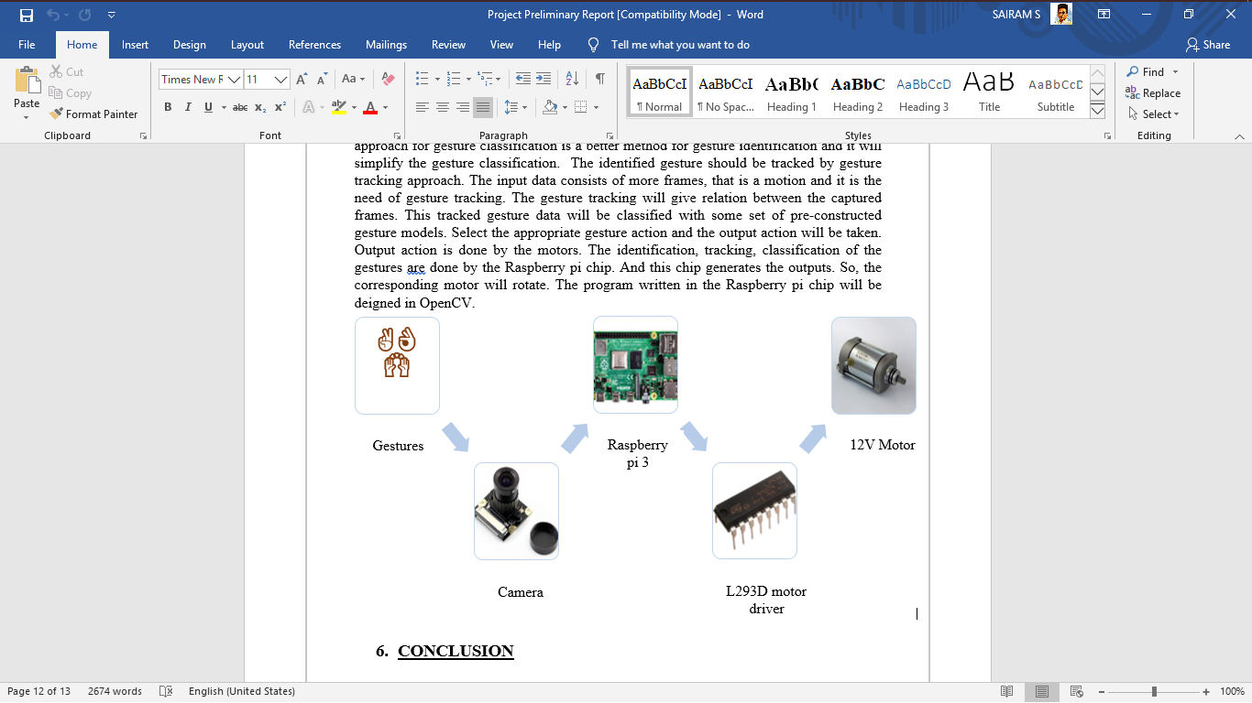
DESIGN & METHODOLOGY

Slide 6
APPLICATION
Gesture controlled motor have a wide range of applications such as
Door/ window control,
Curtain control
It can be used for controlling other things which are difficult to reach.

Slide 7
CONCLUSION
The world is more serious about the life of differently-abled and old-aged people. This project aims towards the betterment of their life.
The gesture controlled motor will bring improvements to their current life. Along with that, life becomes more easier and simpler for everyone.

Slide 8
Reference
Prof. Dr.Amol Kasture, A STUDY ON GESTURE CONTROL ARDUINO ROBOT, ISSN: 2455-2631, May 2018 IJSDR Volume 3, Issue 5.
Prabhu.s, VOICE ENABLED SPEED CONTROL OF AC MOTOR, eISSN: 2319-1163 pISSN: 2321-7308, IJRET, Volume: 03, 02 Feb-2014.
Kimemia Elvis Wanjagi, WIRELESS CONTROL OF A DC MOTOR, University of Nairobi, 2014.
Ezea Hilary, DESIGN OF AUTOMATIC GATE CONTROL USING INFRARED REMOTE WITH PASSWORD PROTECTED FEATURES, ISSN (Online):- 2349-3585, International Journal For Research & Development in Technology Volume: 2, Issue: 5, Nov -2014.

Slide 9
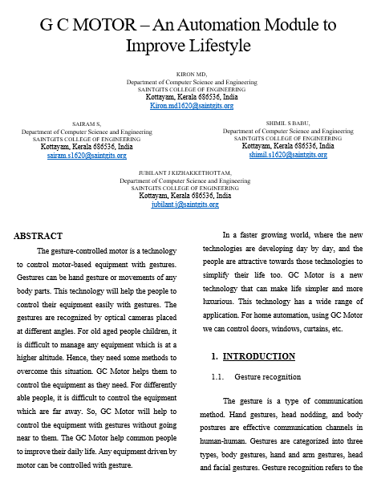
CONFERENCES
5th IEEE ICRAIE - paper reg no, 1570652524
Documents submitted, waiting for approval
8th ICICSE-2020 - paper reg no, 153
Documents submitted, waiting for approval

Slide 10
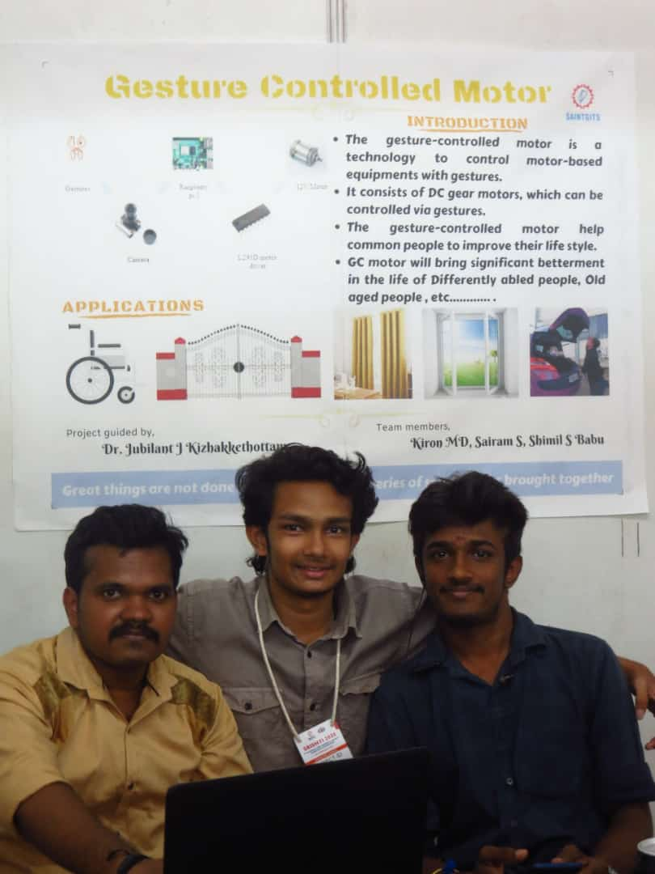
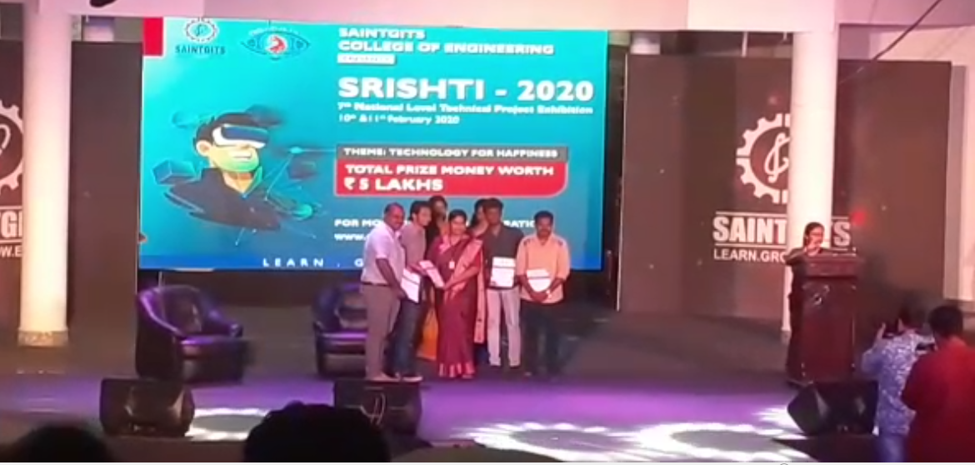
EXHIBITIONS
SRISHTI 2020
2. KTU Project Expo 2020
Request submitted
Notes:
import cv2
import numpy as np
import math
cap = cv2.VideoCapture(0)
while(1):
try: #an error comes if it does not find anything in window as it cannot find contour of max area
#therefore this try error statement
ret, frame = cap.read()
frame=cv2.flip(frame,1)
kernel = np.ones((3,3),np.uint8)
#define region of interest
roi=frame[100:300, 100:300]
cv2.rectangle(frame,(100,100),(300,300),(0,255,0),0)
hsv = cv2.cvtColor(roi, cv2.COLOR_BGR2HSV)
# define range of skin color in HSV
lower_skin = np.array([0,20,70], dtype=np.uint8)
upper_skin = np.array([20,255,255], dtype=np.uint8)
#extract skin colur image
mask = cv2.inRange(hsv, lower_skin, upper_skin)
#extrapolate the hand to fill dark spots within
mask = cv2.dilate(mask,kernel,iterations = 4)
#blur the image
mask = cv2.GaussianBlur(mask,(5,5),100)
#find contours
_,contours,hierarchy= cv2.findContours(mask,cv2.RETR_TREE,cv2.CHAIN_APPROX_SIMPLE)
#find contour of max area(hand)
cnt = max(contours, key = lambda x: cv2.contourArea(x))
#approx the contour a little
epsilon = 0.0005*cv2.arcLength(cnt,True)
approx= cv2.approxPolyDP(cnt,epsilon,True)
#make convex hull around hand
hull = cv2.convexHull(cnt)
#define area of hull and area of hand
areahull = cv2.contourArea(hull)
areacnt = cv2.contourArea(cnt)
#find the percentage of area not covered by hand in convex hull
arearatio=((areahull-areacnt)/areacnt)*100
#find the defects in convex hull with respect to hand
hull = cv2.convexHull(approx, returnPoints=False)
defects = cv2.convexityDefects(approx, hull)
# l = no. of defects
l=0
#code for finding no. of defects due to fingers
for i in range(defects.shape[0]):
s,e,f,d = defects[i,0]
start = tuple(approx[s][0])
end = tuple(approx[e][0])
far = tuple(approx[f][0])
pt= (100,180)
# find length of all sides of triangle
a = math.sqrt((end[0] - start[0])**2 + (end[1] - start[1])**2)
b = math.sqrt((far[0] - start[0])**2 + (far[1] - start[1])**2)
c = math.sqrt((end[0] - far[0])**2 + (end[1] - far[1])**2)
s = (a+b+c)/2
ar = math.sqrt(s*(s-a)*(s-b)*(s-c))
#distance between point and convex hull
d=(2*ar)/a
# apply cosine rule here
angle = math.acos((b**2 + c**2 - a**2)/(2*b*c)) * 57
# ignore angles > 90 and ignore points very close to convex hull(they generally come due to noise)
if angle <= 90 and d>30:
l += 1
cv2.circle(roi, far, 3, [255,0,0], -1)
#draw lines around hand
cv2.line(roi,start, end, [0,255,0], 2)
l+=1
#print corresponding gestures which are in their ranges
font = cv2.FONT_HERSHEY_SIMPLEX
if l==1:
if areacnt<2000:
cv2.putText(frame,'Put hand in the box',(0,50), font, 2, (0,0,255), 3, cv2.LINE_AA)
else:
if arearatio<12:
cv2.putText(frame,'0',(0,50), font, 2, (0,0,255), 3, cv2.LINE_AA)
elif arearatio<17.5:
cv2.putText(frame,'Best of luck',(0,50), font, 2, (0,0,255), 3, cv2.LINE_AA)
else:
cv2.putText(frame,'1',(0,50), font, 2, (0,0,255), 3, cv2.LINE_AA)
elif l==2:
cv2.putText(frame,'2',(0,50), font, 2, (0,0,255), 3, cv2.LINE_AA)
elif l==3:
if arearatio<27:
cv2.putText(frame,'3',(0,50), font, 2, (0,0,255), 3, cv2.LINE_AA)
else:
cv2.putText(frame,'ok',(0,50), font, 2, (0,0,255), 3, cv2.LINE_AA)
elif l==4:
cv2.putText(frame,'4',(0,50), font, 2, (0,0,255), 3, cv2.LINE_AA)
elif l==5:
cv2.putText(frame,'5',(0,50), font, 2, (0,0,255), 3, cv2.LINE_AA)
elif l==6:
cv2.putText(frame,'reposition',(0,50), font, 2, (0,0,255), 3, cv2.LINE_AA)
else :
cv2.putText(frame,'reposition',(10,50), font, 2, (0,0,255), 3, cv2.LINE_AA)
#show the windows
cv2.imshow('mask',mask)
cv2.imshow('frame',frame)
except:
pass
k = cv2.waitKey(5) & 0xFF
if k == 27:
break
cv2.destroyAllWindows()
cap.release()

Slide 11
Thank you
By,
Shimil S Babu, Kiron MD, Sairam S

